Slide 1
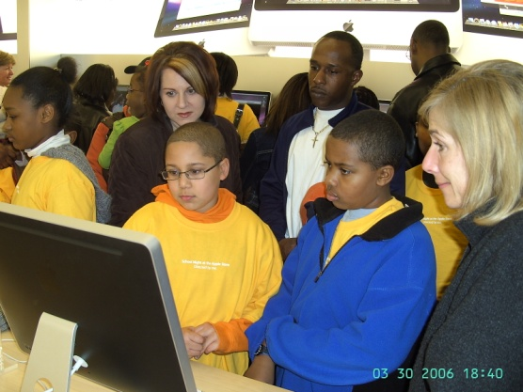
ME4E Utilizes Technology
During programs ME4E could use…
Touch screen computer
Digital Binoculars
Program Specific Blogs
Online Videos
Digital Microscope
GPS receivers
Smart Boards

Slide 2
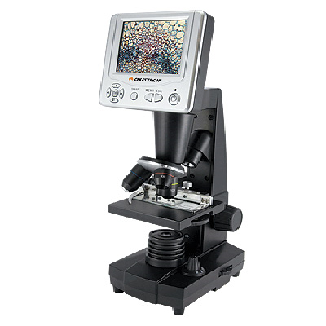
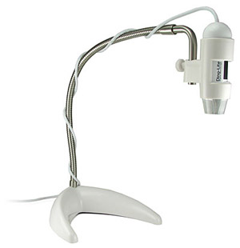
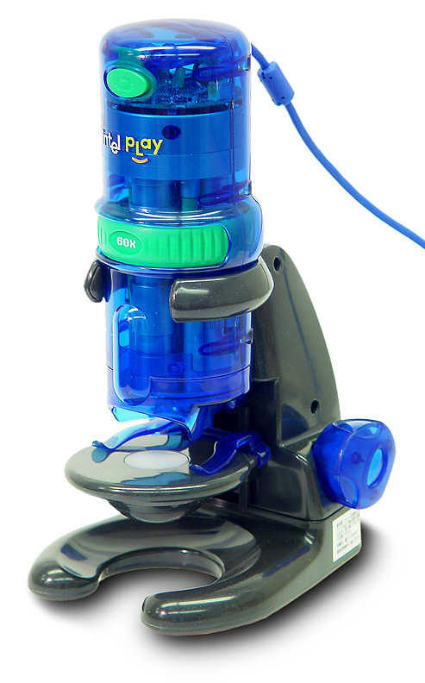
The Digital Microscope
Think about …
Who will be using your technology
Where will it be used
Cost vs. Quality
Ease of use
Training needs
Applications

Slide 3
3 P’s of Technology
Plan
Things are bound to go wrong. Have a back-up plan w/ a low-tech alterative.
Prepare
Participants & presenters need to know what they will be doing and how to properly use the tech before they go “live”.
Personalize
If they participants have a connection to the tech device, they are more likely to retain knowledge and appreciate it.

